Slide 1
DESIGN AND MODELLING OF MICROWAVE PLASMA REACTOR FOR THE PRODUCTION OF NANO-SILICON FROM QUARTZITE.
Presented by-
Sagar Kumar Das
Mydul Islam
Presented to-
Dr. Md. Fakhrul Islam
Professor
Dept of NCE, BUET
Date: 11th December 2023

Slide 2
Whole task can be divided into 3 part
Theoretical study
Simulation
Experiment

Slide 3
THEORETICAL STUDY

Slide 4
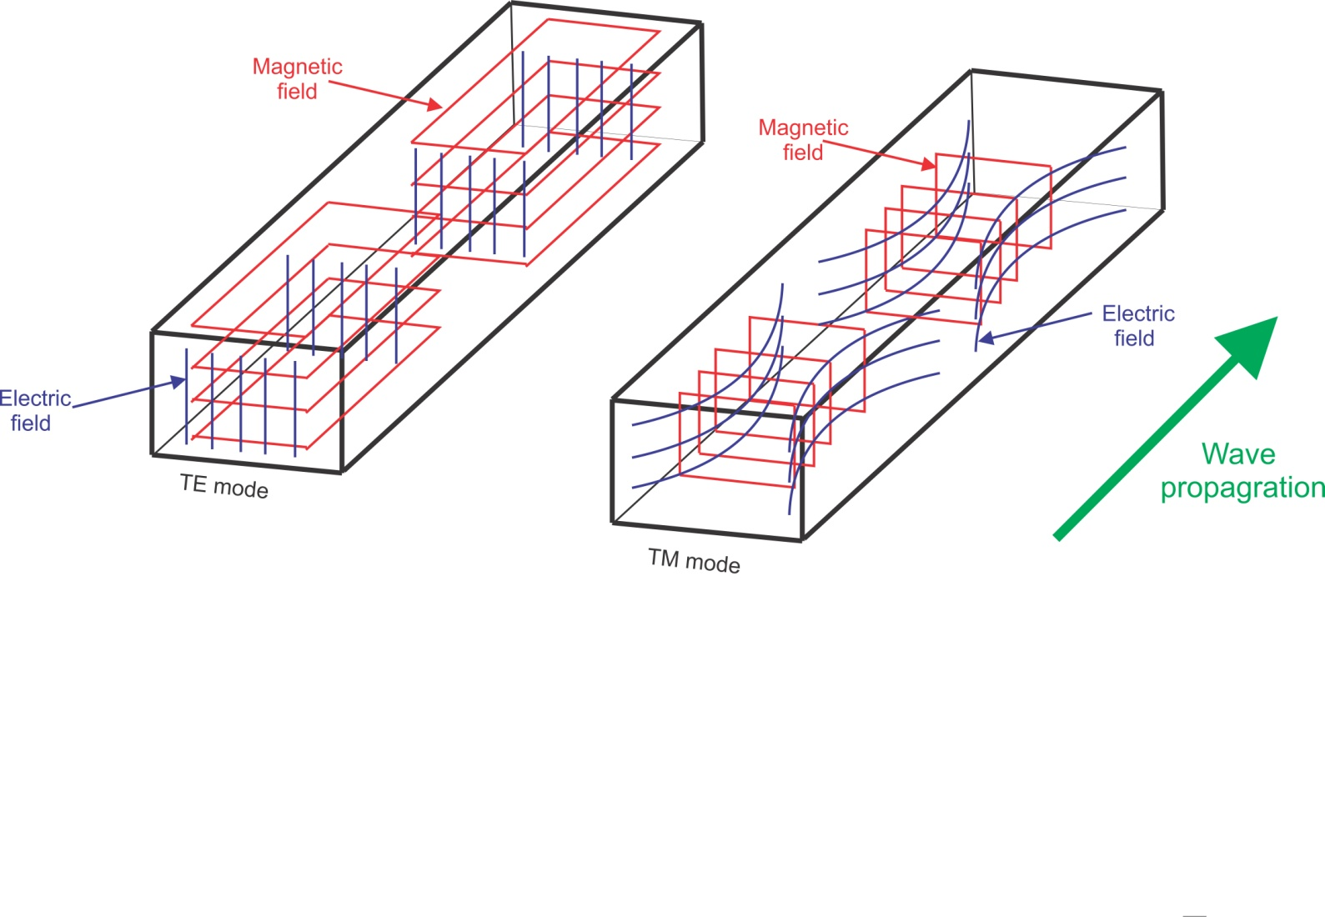
TE & TM Mode in Rectangular Waveguide
Here, TE mode is more significant for plasma generation.
Gas particles ionize in strong Electric field.

Slide 5
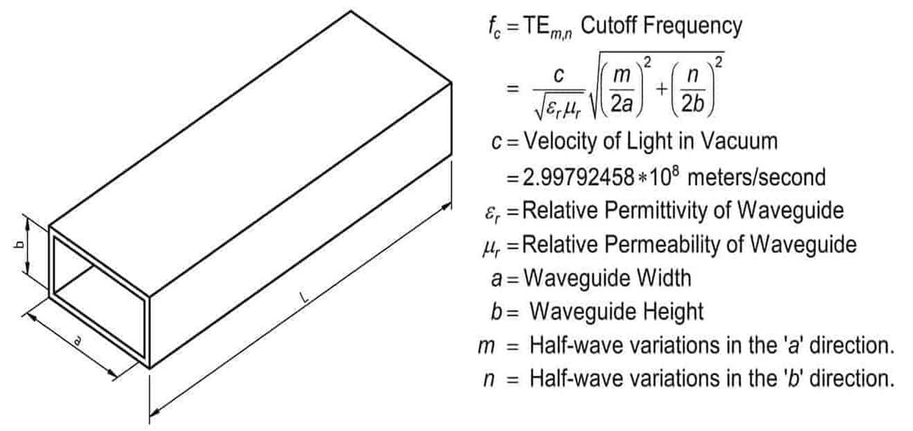
Cut-off Frequency

Slide 6
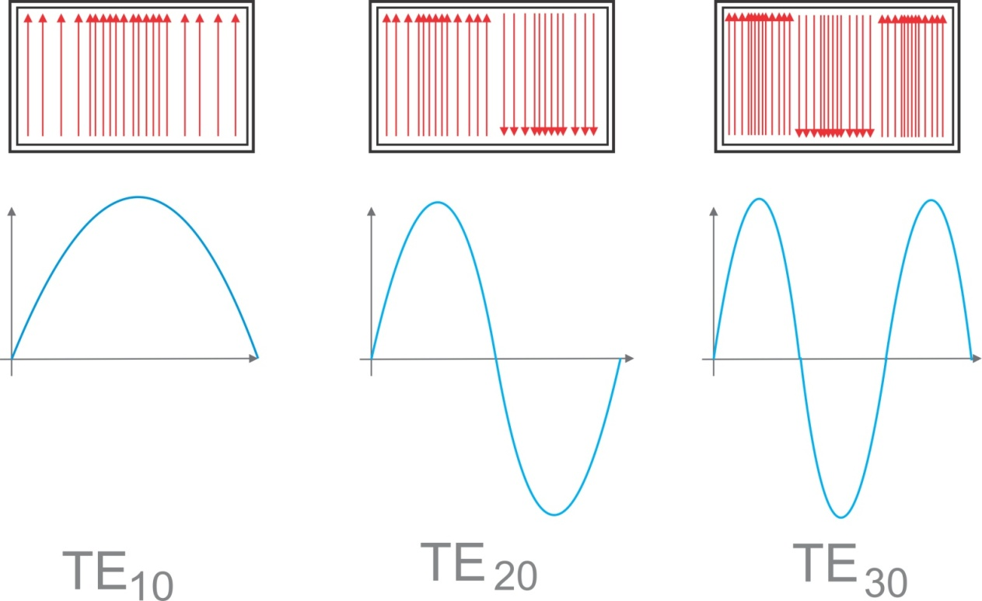
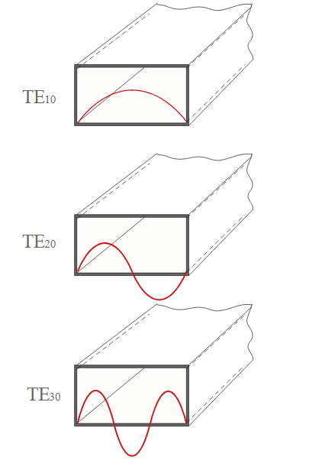
Different Types of TE mode
These modes depends on the dimensions of a waveguide.

Slide 7
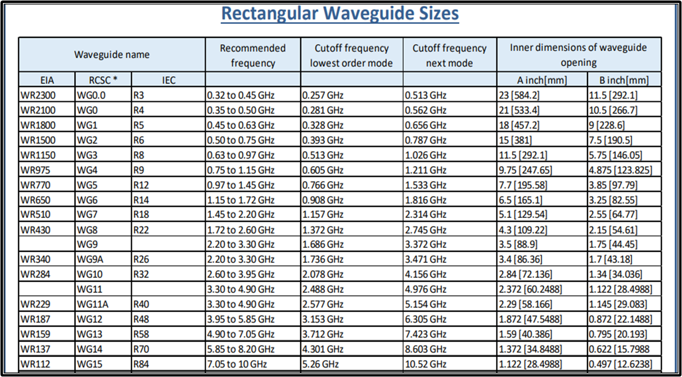
Size VS Frequency
As, Magnetron Frequency is 2.45GHz,so, WR340 basic dimensions have been chosen.

Slide 8
Frequency Analysis
For TE mode, dominant mode is TE₁₀ mode because of having lowest cut off frequency.
if, a=9cm & b=2cm
For TE₁₀
f_{c,10} = 1.66 GHz
For TE₂₀
f_{c,20} = 3.33GHz

Slide 9
As suggested by Prof. Pradeep, IIT, India,
Operating frequncy (f₀) should be at least 25% higher than TE₁₀ mode and 5% less than TE₂₀ mode.
So, actual operating region should be
1.25*f_{c,10} < f₀ < 0.95*f_{c,20}
As, in the lab, Magnetron frequency is f₀ = 2.45GHz, the wave will operate on TE₁₀ mode.
So we may choose ‘a = 9cm’ and ‘b=2cm for optimization case(according to the paper).

Slide 10

Wavelength Analysis
Free Space Wavelength
λ = c/f₀ = 126 mm
Guided Wavelength
λ_{g} = 167 mm
(λ_{g} /4) = 41mm ;
This is an important parameter for designing a 3dB waveguide design.

Slide 11
LOW COST WAVEGUIDE MODEL

Slide 12
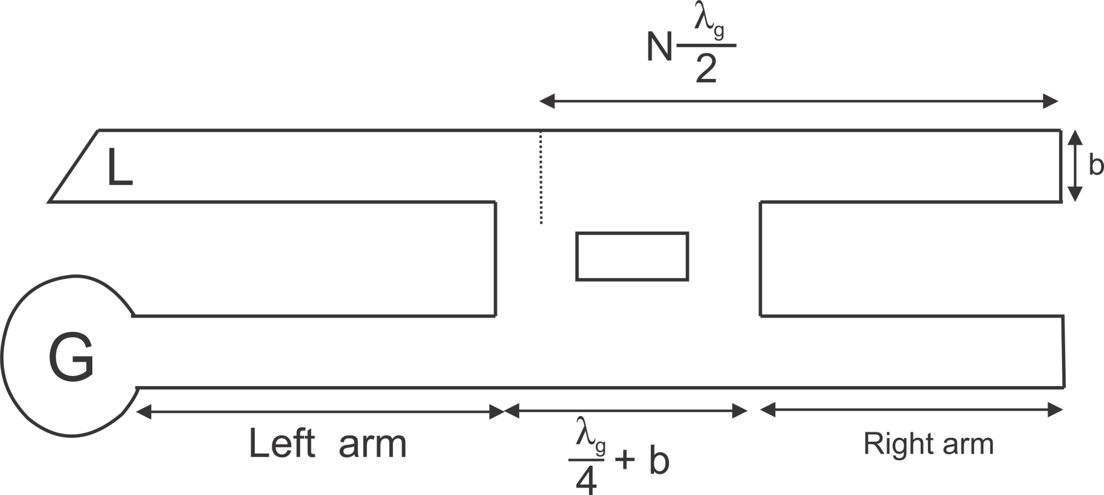

Design with suggested dimensions
1.41*b
b
b
1.41*b

Slide 13
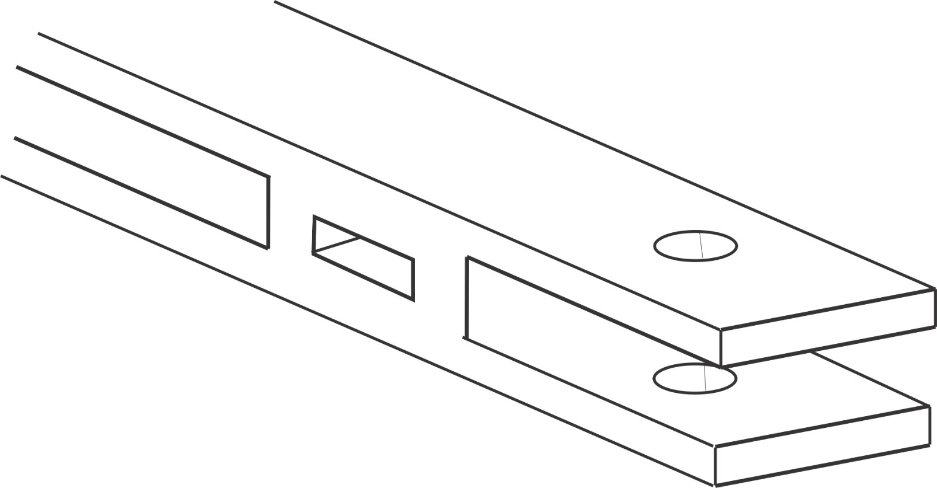
Waveguide Parameters
b = Height of the waveguide
a = Width of the waveguide
L_{Right} = Length of the right arm.
L_{Left} = Length of the left arm.
At the beginning, a=90mm and b=20mm had been taken.
Plasma Chamber
L_{Left}
λ_{g} /4
b
L_{Right}
a

Slide 14
SIMULATION

Slide 15
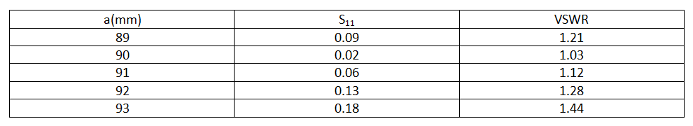
Tolerance of Width ‘a’
Value of width b is very crucial for waveguide design as cut off frequency depends on it. Minor change during fabrication won’t cause any major issue as VSWR is within limit.

Slide 16
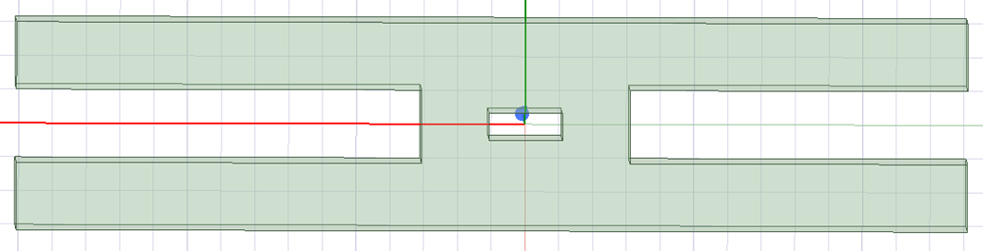
Calculation of Right arm for lower VSWR
L_{Right}
λ_{guide} /4+b
12mm
N*λ_{guide} /2
Here,
b = 17mm
λ_{guide} = 167mm
N = 2,3,4,5……..
From the picture,
N*(λ_{guide} /2) = L_{Right} + (λ_{guide} /4)+b – 12
83.4*N = L_{Right} + 41.7+17-12
L_{Right} = 83.4*N – 46.7
For
N = 2; LR =120mm
N = 3; LR =204mm
N = 4; LR =287mm

Slide 17
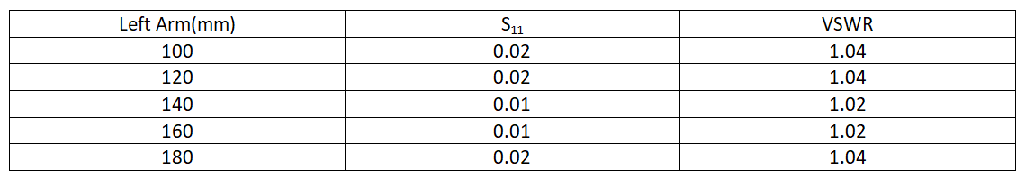
Calculation of Left arm for lower VSWR
Simulation shows that L_{Right} has negligible impact on VSWR.

Slide 18
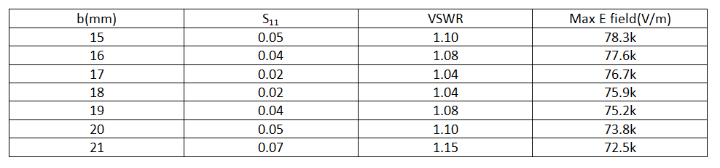
Tolerance of Height ‘b’
17 mm has been chosen because of lower VSWR and Higher electric field intensity.

Slide 19
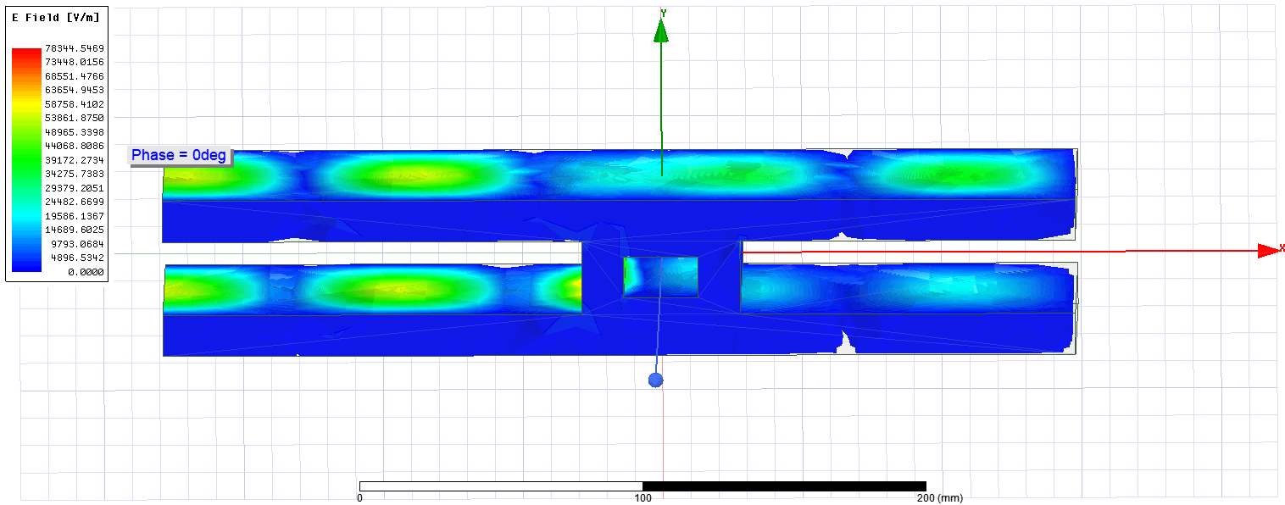
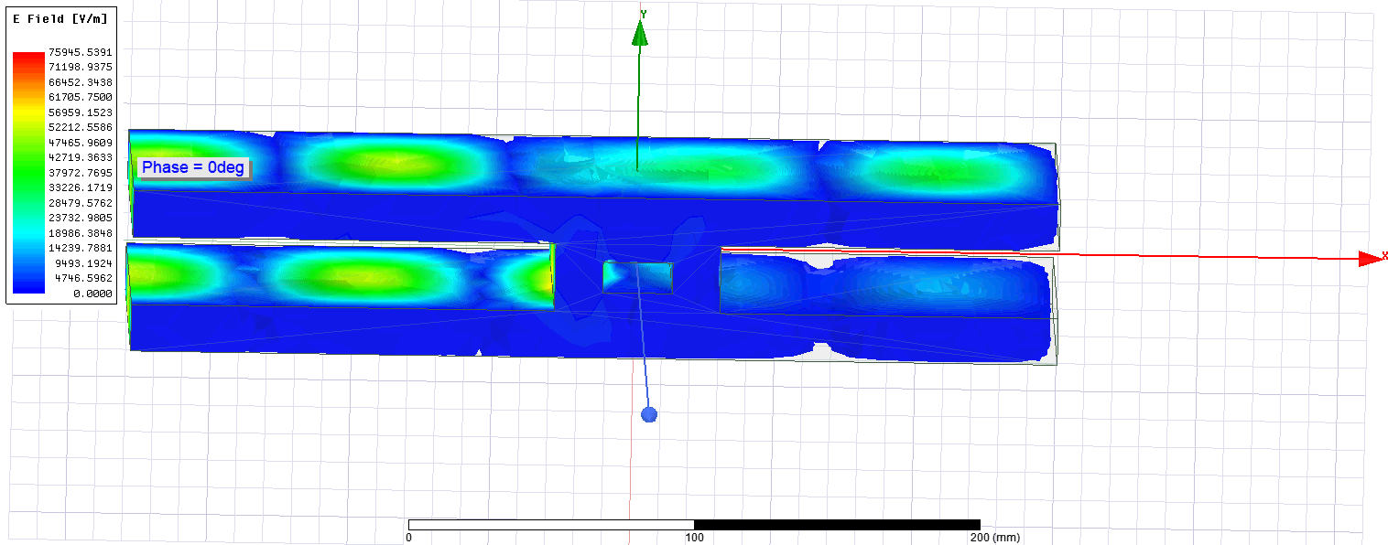
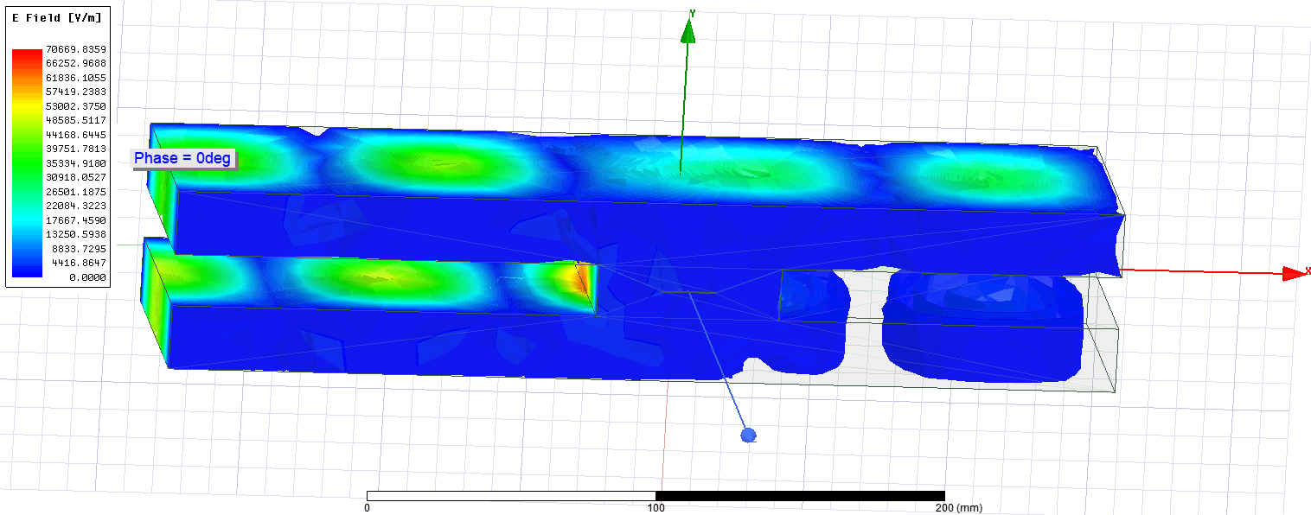
15mm
17mm
23mm

Slide 20
Favorable Dimensions after simulation
Without considering quartz tube, dimensions are given here.
17mm
120mm
120mm

Slide 21
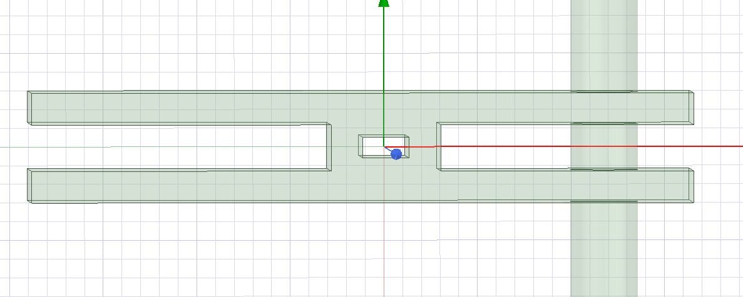
Waveguide Design Considering Air Tube
Radius of the tube has been taken 18mm.

Slide 22
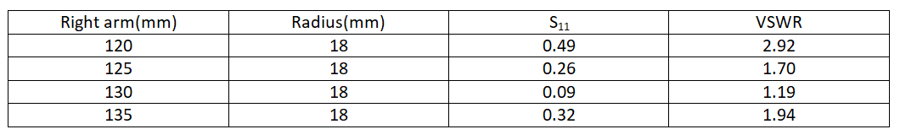
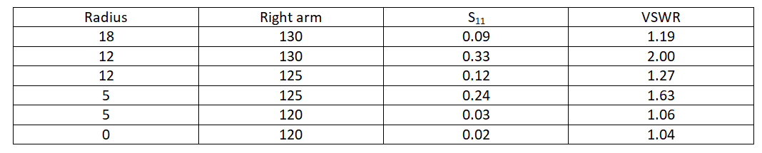
Impact of Air tube
There is visible impact of the tube on the waveguide.

Slide 23
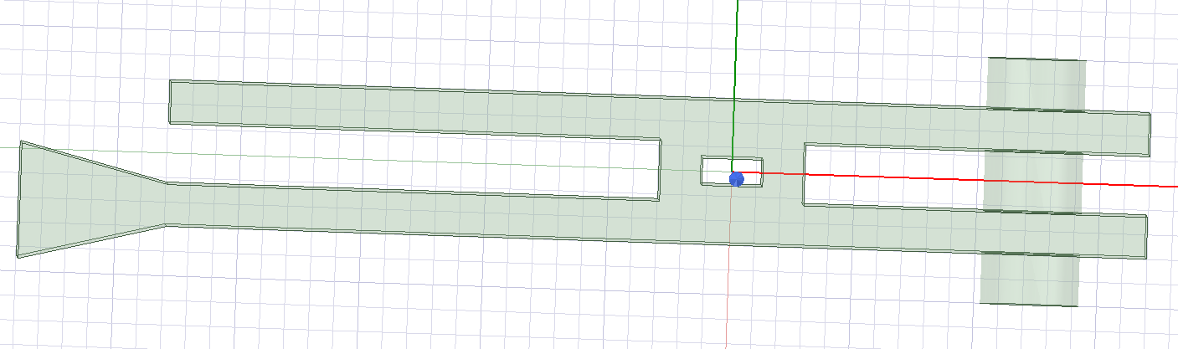
Practical Scenario Observation of the Magnetron side
Lower angle is showing better VSWR
Length of left arm is also impacting VSWR which was not in the previous model.

Slide 24
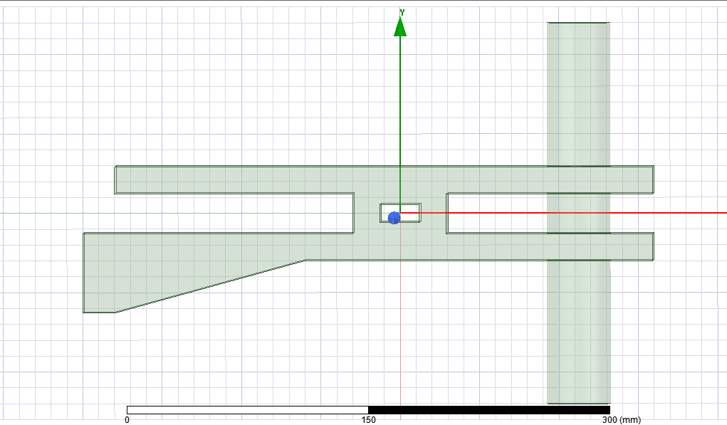
Practical Scenario Observation of the Magnetron side

Slide 25
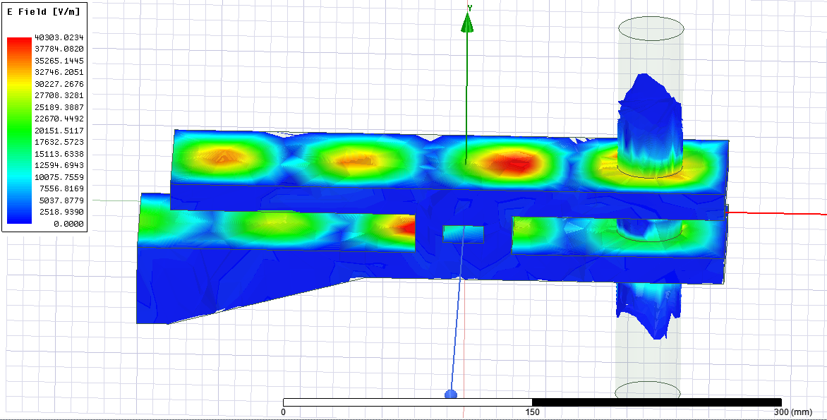
Electric Field analysis

Slide 26
EXPERIMENT

Slide 27
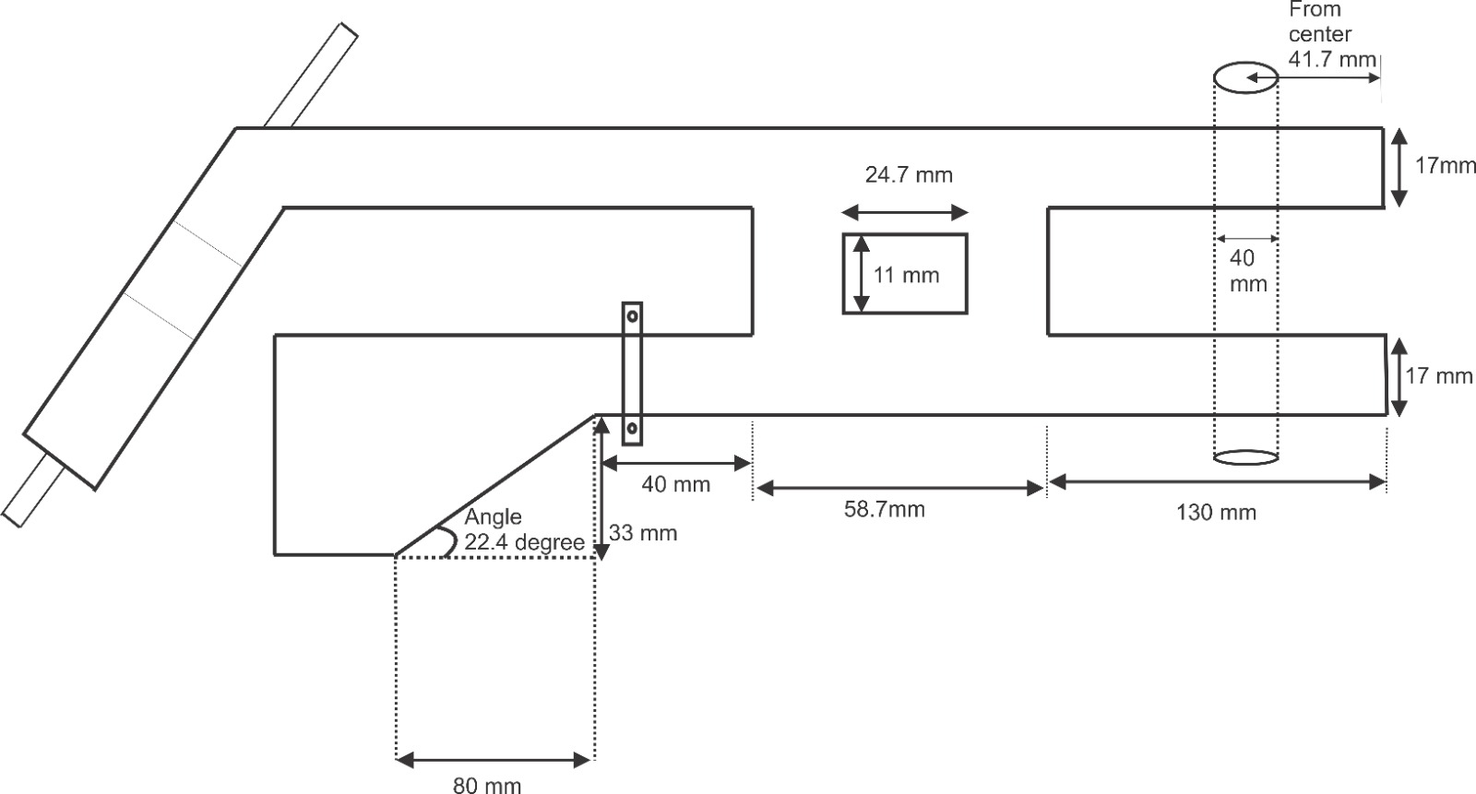
Final Dimensions

Slide 28
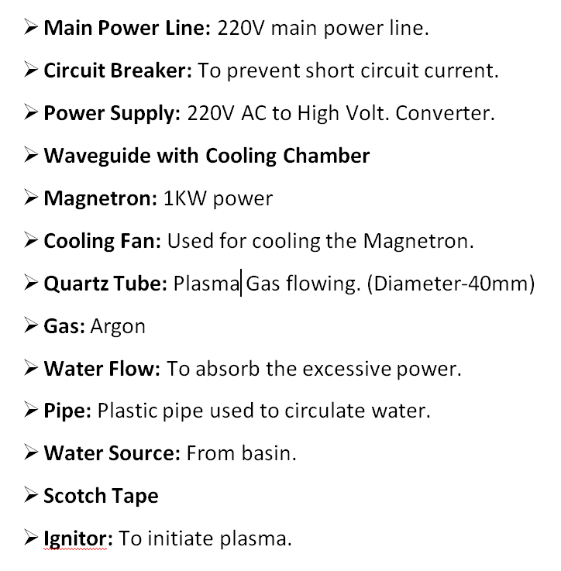
Necessary Connection and Equipments

Slide 29
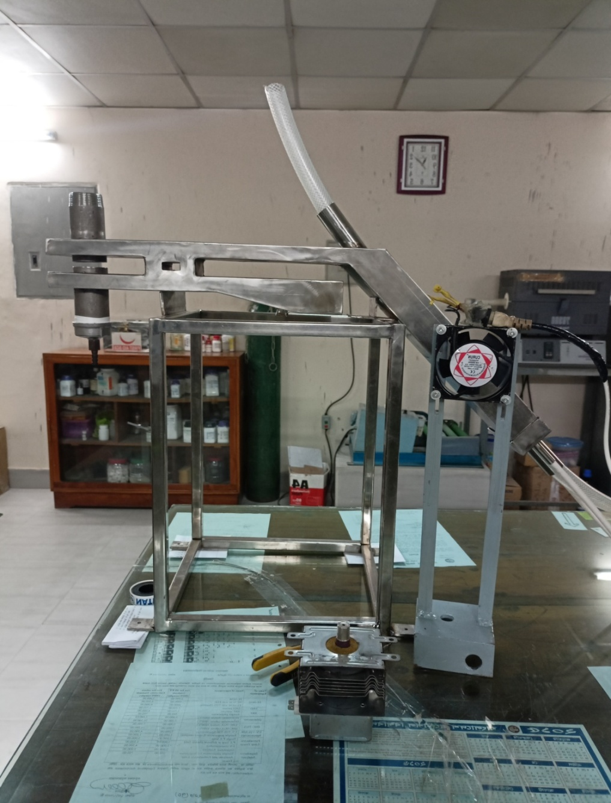
Waveguide after fabrication

Slide 30
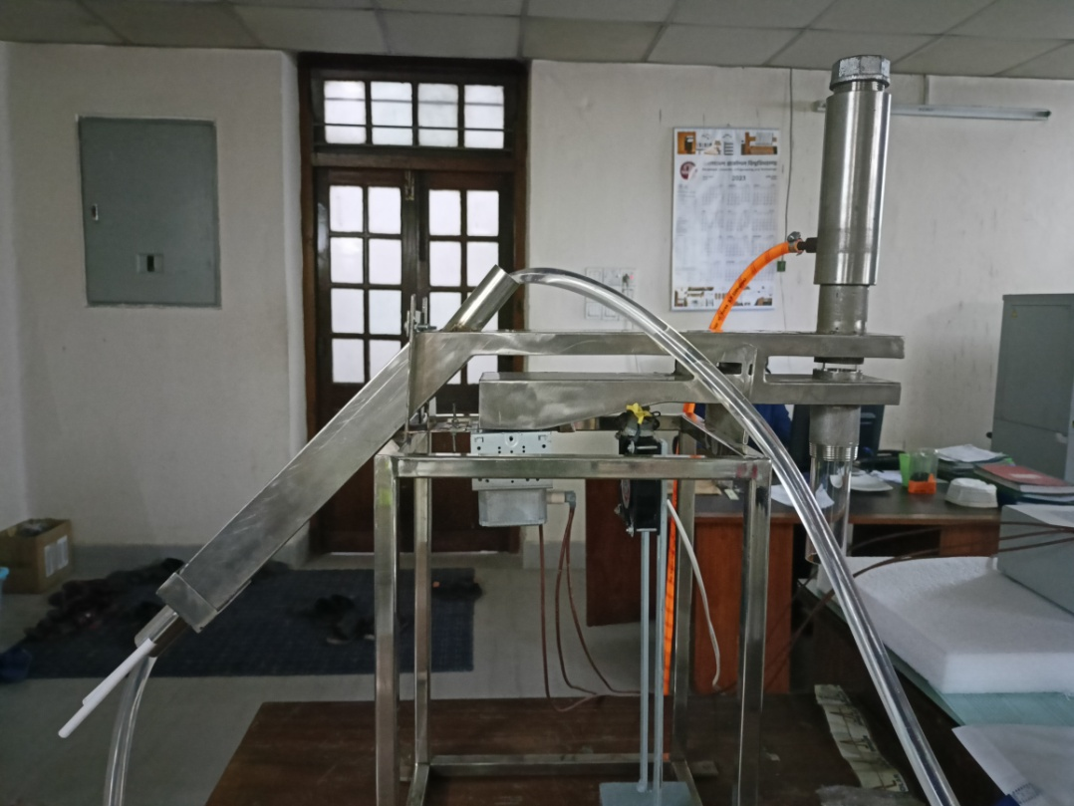
Full Set-up

Slide 31
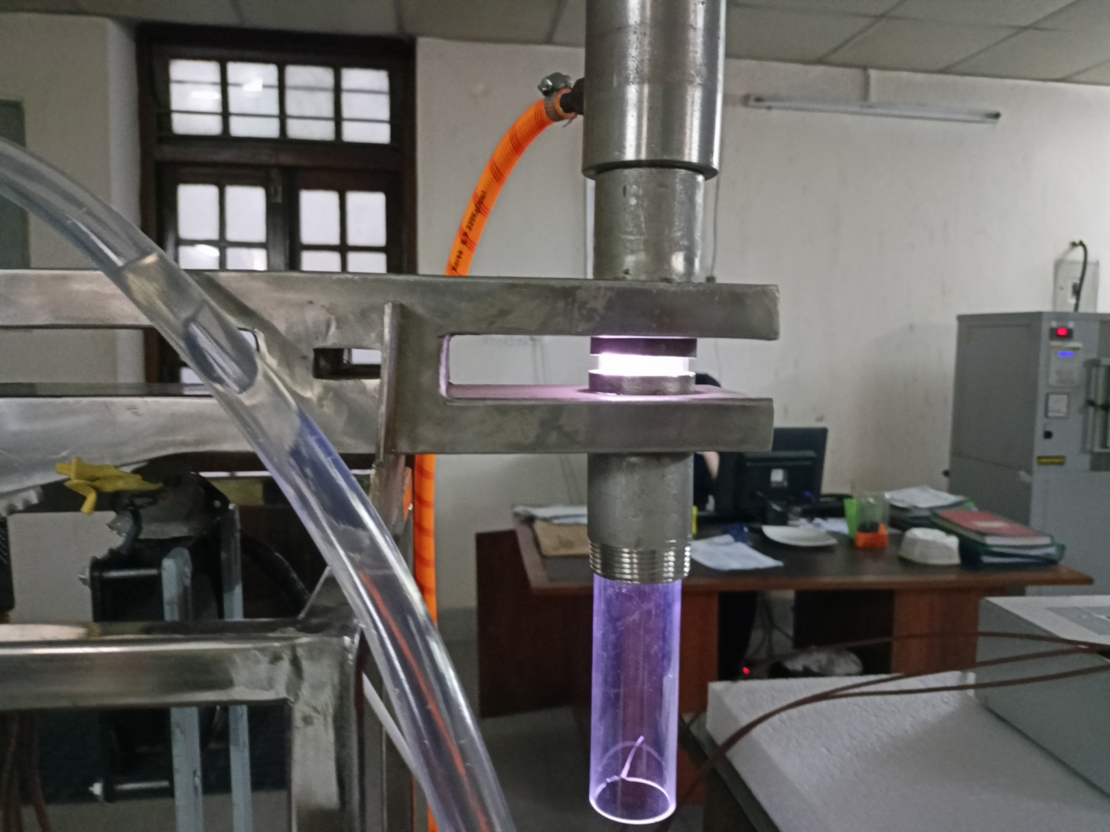
Test run and plasma

